Slide 1
Using Data to Predict the Next Hit Album
A Springboard Capstone Project
By Jessica Wulzen

Slide 2
Problem Statement
Music critics play a key role in promoting new releases from up and coming artists
Understanding what kinds of music critics respond well to will help aspiring musicians craft albums, and record labels to make informed decisions about what acts have the best chance of being successful

Slide 3


Data
The most widely used music streaming platform
Spotify’s API contains a tremendous amount of data about every song, such as: key, time signature, energy, loudness, acousticness, speechiness, and much more
#1 Website for music reviews
Over 17,000 reviews from 1996 to 2017
Each review contains a numeric score from zero to ten

Slide 4
Data Cleaning
The data needs to be prepared so that the albums in the Pitchfork dataset can be searched for in the Spotify API
Many albums have differences in how they are listed in the two data sources, such as:
Fleet Foxes - Sun Giant EP vs Fleet Foxes - Sun Giant
Massive Attack - Mezzanine vs Massive Attack - Mezzanine [Remastered]
To fix this, regular expressions are used to remove troublesome phrases such as ‘EP’ and other common sources of discrepancies

Slide 5
Using the Spotify API
The python package Spotipy allows for easy use of the Spotify API
Spotify limits results to a certain number, making it difficult to find obscure musicians and albums
To find as many matches as possible, we’ll look for matches in two ways: Sun Giant by Fleet Foxes
Search for the album ‘Sun Giant’
Check to see if the musician is ‘Fleet Foxes’
Search for the musician ‘Fleet Foxes’
Retrieve the list of albums released by this musician
Search for a match on the album name ‘Sun Giant’
Using this two-part algorithm, we are able to find 12k albums in Spotify out of 17k reviews

Slide 6
Exploratory Data Analysis
To understand the data, we’ll look for how certain variables are related with each other and how they may have changed over time, such as:
How have review scores changed over time?
How has music itself changed over time?
Does the key music is composed in impact the review score?
Are certain genres of music better-received than others?

Slide 7
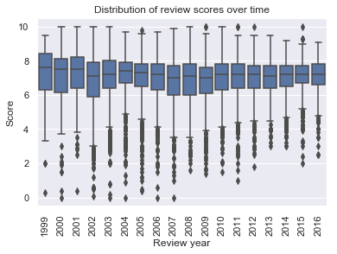
Review Scores over Time
Over time, we observe a change in how Pitchfork has issued scores for reviews
While the average score has remained consistent at around a 7, the distribution has consistently gotten more tightly focused around the mean
In other words, Pitchfork has given less extreme scores over time

Slide 8
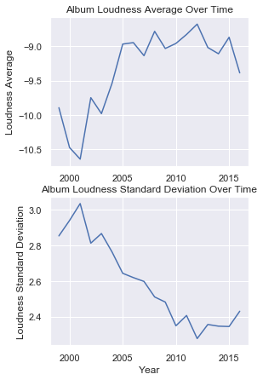
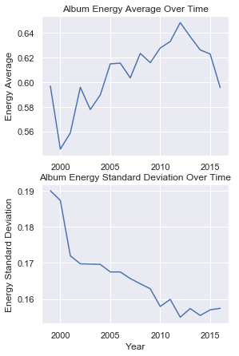
How music has changed over time
Using Spotify’s musical attribute data, we can look at trends in music over time
From these, it is clear that music has gotten louder and more energetic over time
As well, the album energy and loudness standard deviation has dropped over this time, meaning albums have varied less and less over time - music is louder, more energetic, and songs on an album tend to be more similar to each other than they used to be

Slide 9
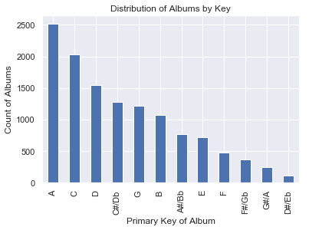
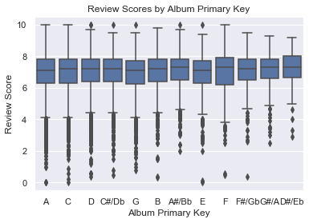
Music by key
One way of looking at these albums is examining the primary key they are composed in
Some keys are vastly more common than others
The obscure keys tend to do better than the popular ones, and do not typically get extremely low scores

Slide 10
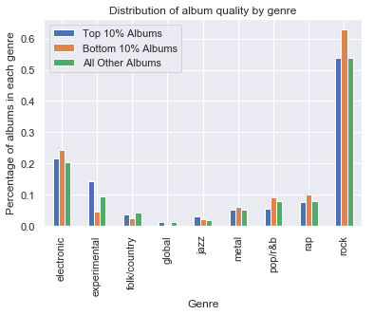
Music by Genre
Breaking albums up into quality categories by review score and looking at how genre impacts this reveals that:
Rock, Electronic, Pop/R&B and Rap are overrepresented in the bottom 10%
Experimental music is massively overrepresented in the top 10%
Other genres have even distributions

Slide 11
Still to come...
Having cleaned, prepared, merged, and explored the data…
Next up: apply machine learning algorithms to predict review scores!

